Slide 1
Incorporating Low Dose Radiation Information into US Laws, Regulations and Policies: Challenges and Opportunities
Paul A. Locke, JD, DrPH
Johns Hopkins Bloomberg School of Public Health
Department of Environmental Health and Engineering
Baltimore, MD
plocke@jhu.edu

Slide 2
Presentation Overview
Background, perspective, disclosures
Drive-by tour of US laws, regulations and policies on ionizing radiation
How IR science is traditionally incorporated into US laws, regulations and policies
An evolving view of risk assessment
Potential way forward – opportunities and challenges incorporating low dose IR into US laws, regulations and policies

Slide 3
Introduction, perspective, disclosure

Slide 4
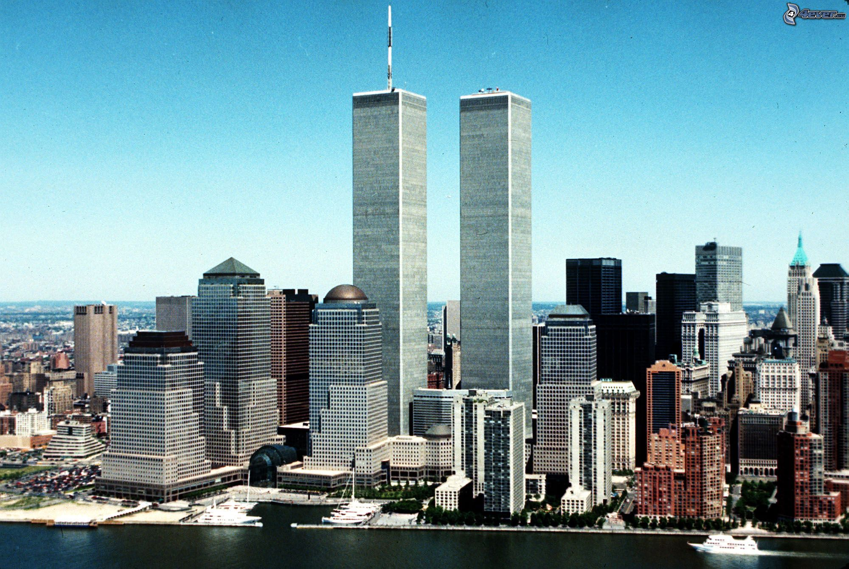
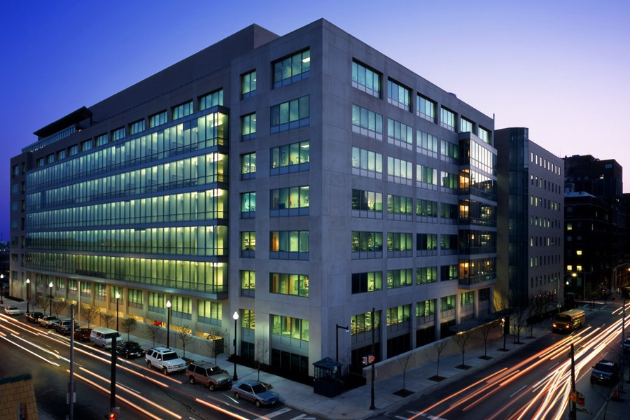
From Wall Street to Wolfe Street

Slide 5
My disclosures
I have no financial conflict of interest to disclose.
I am a member of EPRI’s low dose radiation advisory committee.
I chair Columbia University’s Advisory Council for its Center for Radiological Research.
I have served as an expert witness in two uranium mining cases (one in Canada, one in the US).
I have publicly taken the position that low dose radiation research is important and should be funded.
The opinions expressed in this presentation are mine and do not represent the positions or policies of Johns Hopkins Bloomberg School of Public Health or the Johns Hopkins University.

Slide 6
US laws, regulations and polices applicable to ionizing radiation

Slide 7
Mental Map of US Laws, Regulations
and Policies on ionizing radiation
Nuclear Fuel Cycle
Extraction/Mining
Processing
Fuel Fabrication
Disposal
Medicine
Devices
Radiotherapy
Workers
Traditional (Terrestrial)
Non-traditional (Space)
Naturally occurring
Radon
NORM/TENORM
Extra-terrestrial/cosmic
Compensation
Emergencies
Terrorism
Natural Disasters
Waste/disposal
Air/Water/Land

Slide 8
Some examples
Fuel Cycle (NRC licensees) = AEA
10 CFR Part 20, subpart D – Radiation dose limits to the public
10 CFR Part 20, Subpart C – Occupational dose limits
10 CFR Part 50 -- Domestic Licensing of Production and Utilization Facilities
Naturally occurring
Radon – IRAA, Title IV of CERCLA amendments of 1986 (no regulations – RRNC, “action level” for radon in homes)
TENORM – not directly regulated (but could be under RCRA)
Cosmic radiation – not regulated
Outdoor air
Clean Air Act – NESHAPs – For example, 40 CFR Part 61, Subpart W
Compensation – RECA
28 CFR Part 79 (eligibility criteria)

Slide 9
Lessons learned
Not all sources of IR are regulated
Choice made not to regulate even though there is authority to do so
Authority to regulate is not available or excluded
Use of IR science in laws, regulations and policies varies (a continuum)
Can be very influential (10 CFR Part 20)
Can be minimally influential (28 CFR Part 79)
If IR science is used, it is generally incorporated into risk assessment methodologies
Support regulatory decision-making
Support setting of voluntary guidelines

Slide 10
Risk assessment – how IR science is traditionally incorporated into US laws, regulations and policies

Slide 11
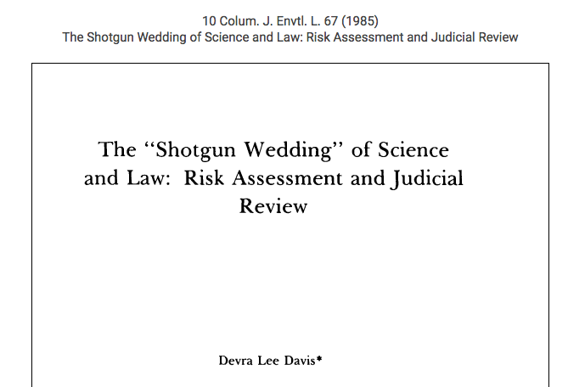

Slide 12
Traditional Environmental Risk Assessment
Arose out of struggles in early 1980s
The Benzene Case and its impact on US federal agencies
How to best take advantage of scientific information when setting protective standards, levels, guidelines
How to incorporate new, expanding research
Risk assessment outlined/refined
“Red Book” 1983
“Science and Judgment” 1994
“Science and Decisions” 2009
Basic conceptual model – four part process
Hazard
Dose-response
Exposure
Characterization

Slide 13
Source: NASEM, Science and Decisions: Advancing Risk Assessment (2009) p.11

Slide 14
IR dose/response
LNT underpins federal (and international) radiation protection paradigm
Meant to be protective and conservative
Recent epidemiology in low dose range generally supports LNT but is not entirely consistent
Recent radiobiology studies show variability in response at molecular, cellular and tissues levels that show nonlinearity in certain circumstances

Slide 15
An evolving view of risk assessment

Slide 16
Fig. 1. Systems biology approach to toxic interactions (Andersen et al. 2005)
[Locke, Incorporating Information From the U.S. Department of Energy Low-Dose Program Into Regulatory Decision-making: Three Policy Integration Challenges, Health Physics 97(5):510-5 (2009)]

Slide 17
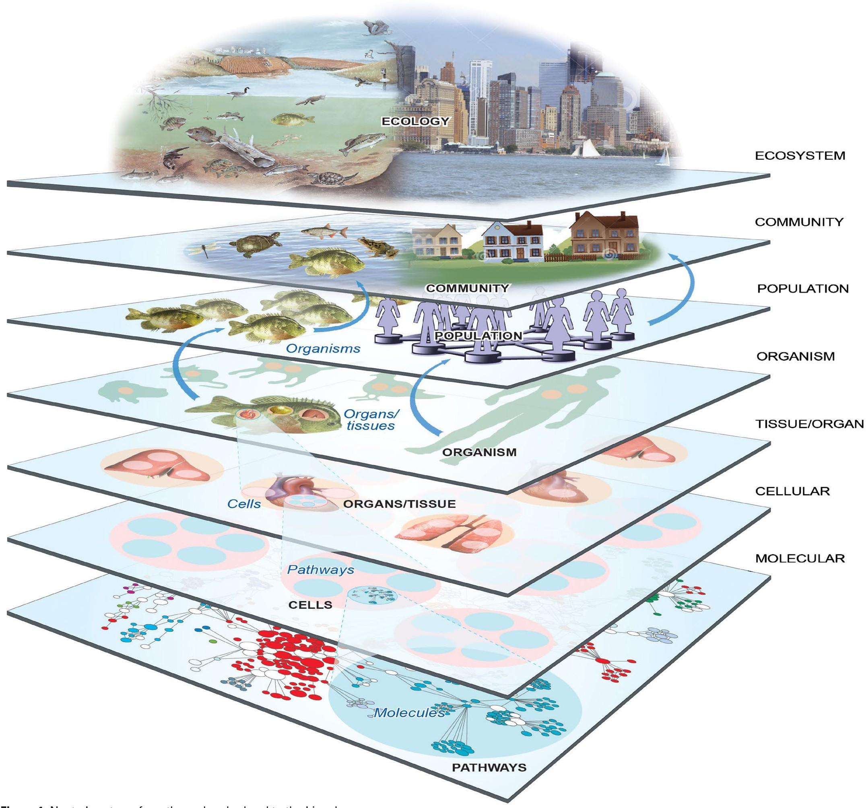
Source: Burke, et al., Rethinking Environmental Protection:
Meeting the Challenges of a
Changing World. Environmental Health Perspectives 125(3):A43 to A49. March 2017

Slide 18
Adverse Outcome Pathway Process for
Organizing Low Dose Radiation Research
Source: Figure 2, EPRI International Dose Effect Alliance Workshop, 2017 (available at https://www.epri.com/#/pages/product/3002012489/?lang=en)

Slide 19
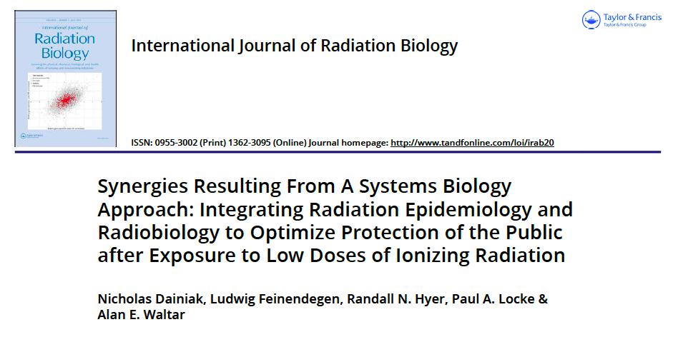

Slide 20
An integrative role for systems biology
There is a strong interest in understanding the process of disease progression and its relationship to ionizing radiation
Interaction of cell function, signaling – not merely isolated parts
Integrating information across systems
Concept of systems biology
Holistic way to evaluate and predict outcomes
Interdisciplinary

Slide 21
"Traditional ERA approaches used to understand the impacts of chemical exposure rely heavily on short-term acute and/or chronic in-vivo toxicity tests using various model species combined with a variety of assessment factors to derive toxicity thresholds.
However, since these factors lack a mechanistic basis, they have limited potential for quantitatively estimating cross-species toxicity thresholds. AOPs provide a real opportunity to create a future framework for ERA based on a mechanistic, exposure driven understanding at its core.”
Page 100 (Section 5.6: Conclusion (emphasis added))

Slide 23
Evaluating biological responses in the low dose range
In vitro studies (cellular and molecular systems) do not adhere to a linear dose-effect function
Not a clear picture -- incomplete understanding of mechanistic interactions
Cell repair, intracellular communications, adaptive response need further investigation
Redox biology emerging as an important area of study – signaling molecules such as H₂O₂
New and novel laboratory investigative tools can help understand signaling at gene, cellular organoid level

Slide 24
The path forward – research and regulatory acceptance

Slide 25
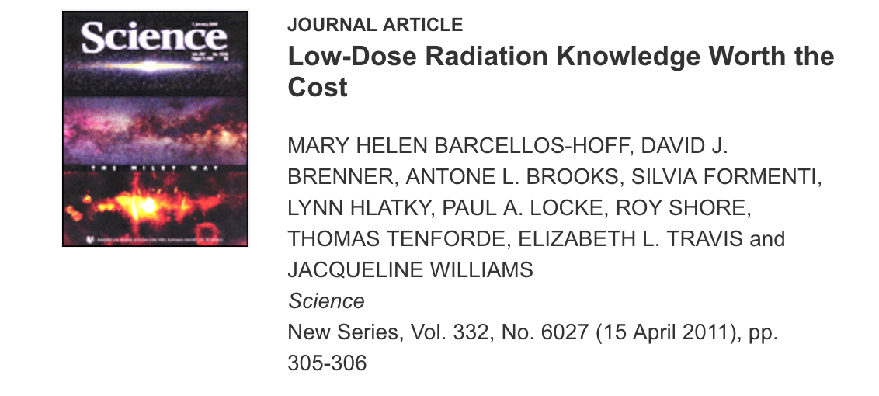

Slide 26
Expanded research agenda to “field test” AOP risk assessment
Additional laboratory-based low dose IR research is not enough
Consider:
Historical case studies to show that:
AOP risk assessment is protective
AOP risk assessment would have improved past decision-making
Examples of how AOP risk assessment could be useful for current issues facing decision-makers
Show how AOP risk assessments can create a level playing field for epidemiology and radiobiology that leads to better public health protection

Slide 27
Regulatory Acceptance of AOP Risk Assessment
Demonstrate that AOP risk assessment is better than traditional risk assessment
Better incorporation and utilization of scientific information
Better integration (ie., weighing, prioritizing)
Better capture of variability
Demonstrate that AOP risk assessment will lead to better health and environmental protection (risk management)
Demonstrate the AOP risk assessment is consistent with laws and regulations it is meant to implement
Demonstrate that AOP risk assessment advances the mission of the agency using it

Slide 28
Conclusions
Opportunities
Incorporate low dose IR into the development of US laws, regulations and policy
Expand/improve/evolve traditional risk assessment
Better public health protection and utilization of IR low dose science
Challenges
Need for additional IR low dose research
Need to expand research agenda – scholarship of applicability
Regulatory acceptance of evolved IR risk models

Slide 29
Paul A. Locke, MPH, JD, DrPH
Associate Professor
Department of Environmental Health and Engineering
plocke@jhu.edu
@DrLockeJHU

